Slide 6
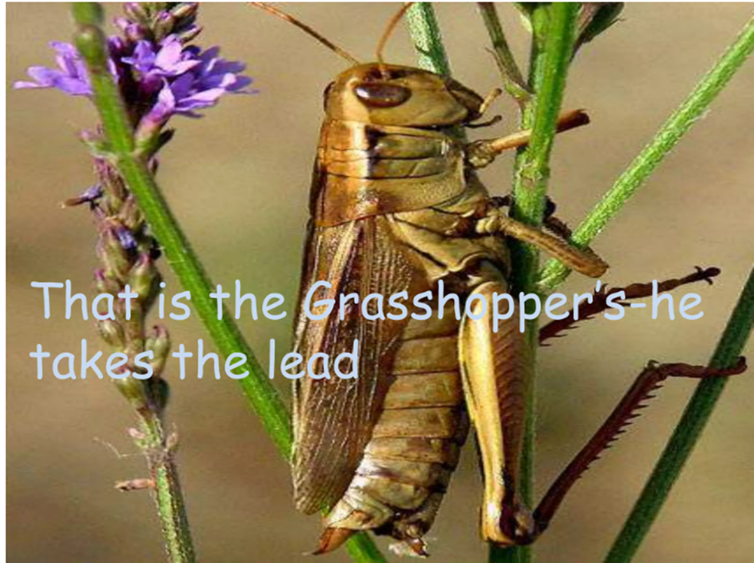

Slide 7
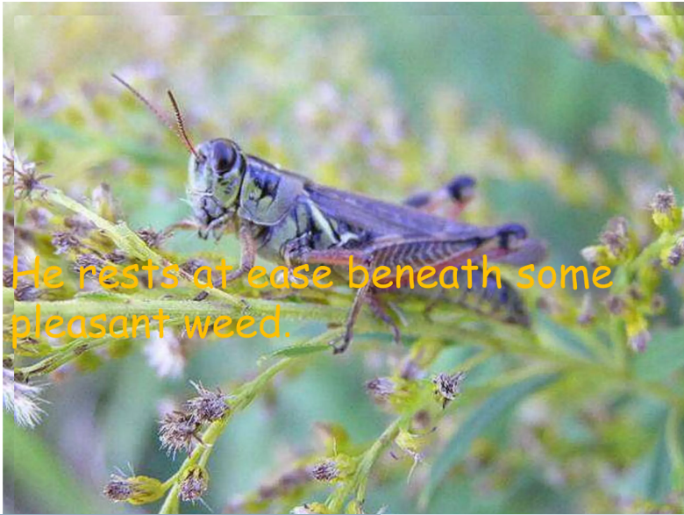

Slide 8
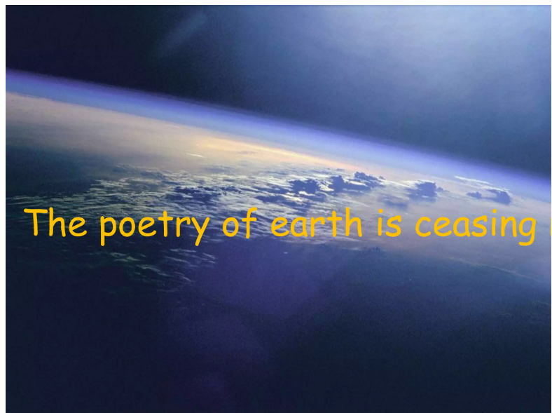

Slide 10
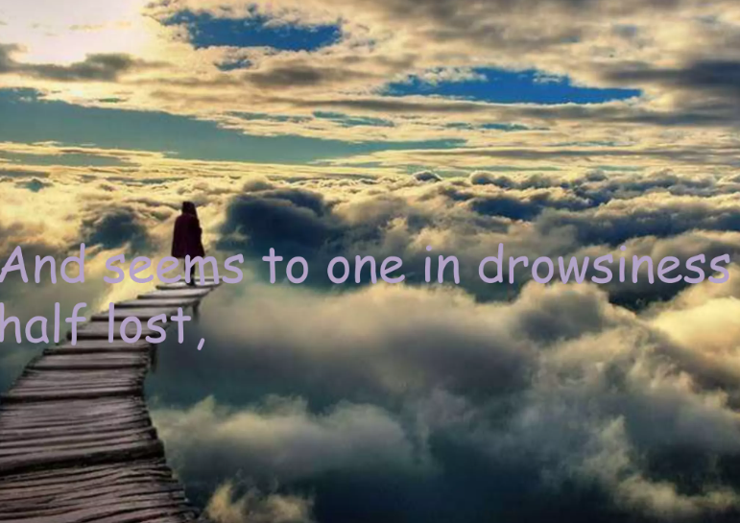

Slide 12
Nithya Prakash /FACULTY/English/SNSACD

Slide 14
Nithya Prakash /FACULTY/English/SNSACD

